Slide 1

Project Salary Predictions of Data Professions
Done By
Adabala Devi
MIP-ML-12

Slide 2
Problem Statement:
Salaries in the field of data professions vary widely based on factors such as experience, job role, and performance. Accurately predicting salaries for data professionals is essential for both job seekers and employers.

Slide 3
Step-by-Step Instructions:
Install Anaconda:
If you haven't installed Anaconda, download and install it from the official website.
Launch Anaconda Navigator:
Go to the Windows search bar.
Type "Anaconda Navigator" and click on the application to open it.
Open Jupyter Notebook:
In Anaconda Navigator, find the "Jupyter Notebook" application.
Click on the "Launch" button next to Jupyter Notebook. This will open Jupyter Notebook in your default web browser.
Create a New Notebook:
In Jupyter Notebook, navigate to the directory where you want to save your work.
Click on the "New" button on the right side and select "Python 3" to create a new notebook.

Slide 4
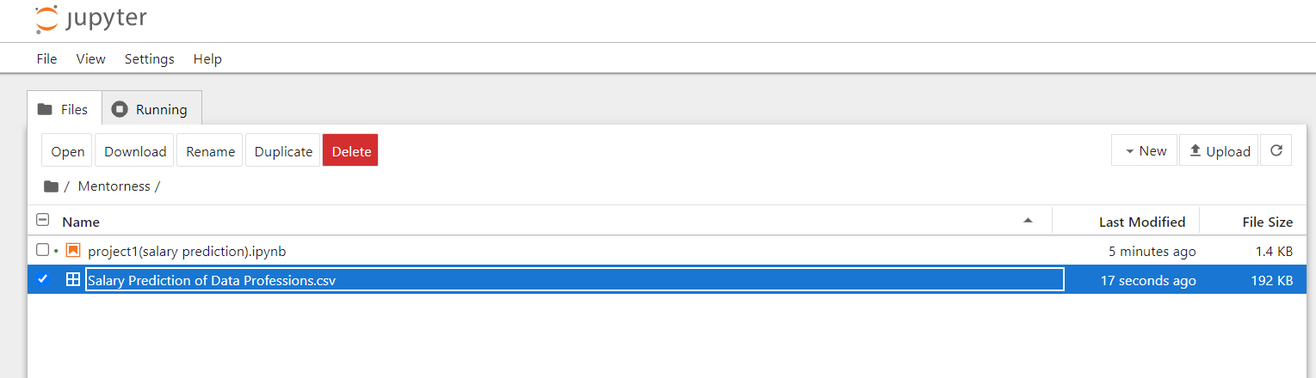

Slide 5
To build a predictive model for salaries of data professionals.You will follow these key steps:
Steps:
Import Libraries
Load the Dataset
Exploratory Data Analysis (EDA)
Feature Engineering
Data Preprocessing
Machine Learning Model Development
Model Evaluation
ML Pipelines and Model Deployment
Recommendations

Slide 6
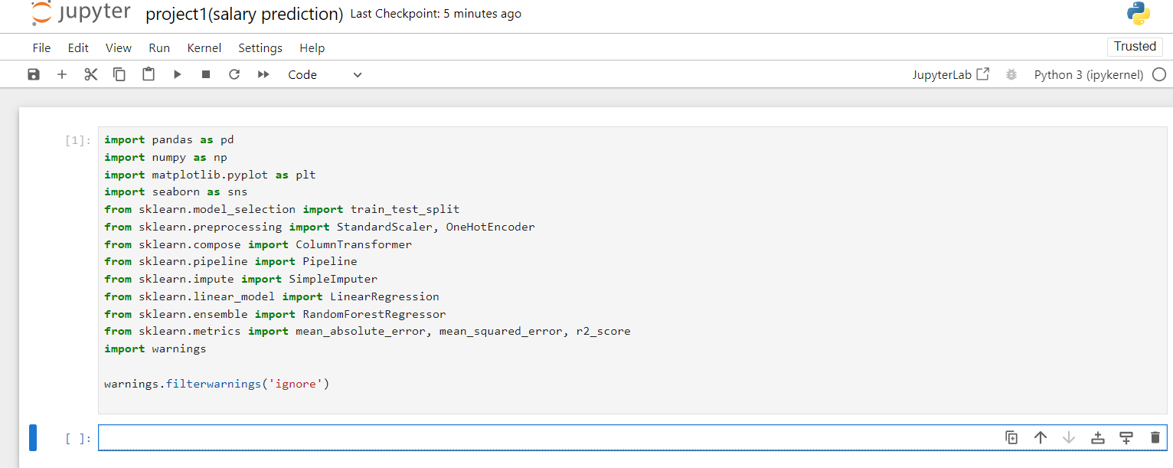
Steps:
1.Import Libraries
In the first cell of your new notebook, import the necessary libraries.

Slide 7
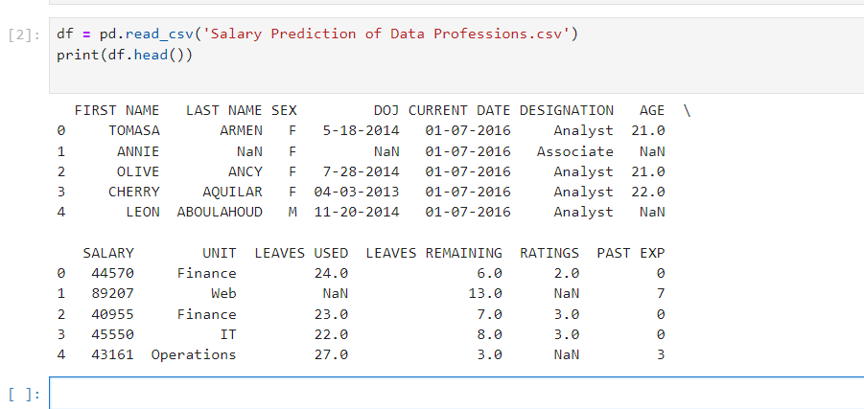
2.Load the Dataset:
In the next cell, load your dataset (make sure your dataset is in the same directory as your notebook or provide the correct path).

Slide 8
3.Exploratory Data Analysis (EDA):
Conduct EDA to understand the dataset better.
Dive into the dataset, conduct comprehensive EDA, and unveil valuable insights about data professionals' salaries.EDA will involve data visualization, summary statistics, and identifying patterns in the data.
4.Feature Engineering:
Create and transform features to improve model performance.
Create new features or transform existing ones that can provide additional insights or improve model performance.
Feature engineering might involve deriving features related to experience, job role, and performance
.
5.Data Preprocessing:
Prepare the data for model training.
This includes handling missing values, encoding categorical variables, and scaling or normalizing features as needed.

Slide 9
6.Machine Learning Model Development:
Train various machine learning regression models to predict salaries.
Experiment with different algorithms such as linear regression, decision trees, random forests, and gradient boosting to find the best-performing model.
7.Model Evaluation:
Assess the performance of your models using appropriate evaluation metrics like Mean Absolute Error (MAE), Mean Squared Error (MSE), Root Mean Squared Error (RMSE), and R-squared (R2) score.
Identify the model that provides the most accurate salary predictions.
8.ML Pipelines and Model Deployment:
Create ML Pipelines to streamline the end-to-end machine learning process, from data preprocessing to model training.
Additionally, deploy a model that can generate predictions for unseen data. Consider using frameworks like Flask or FastAPI for deployment.

Slide 10
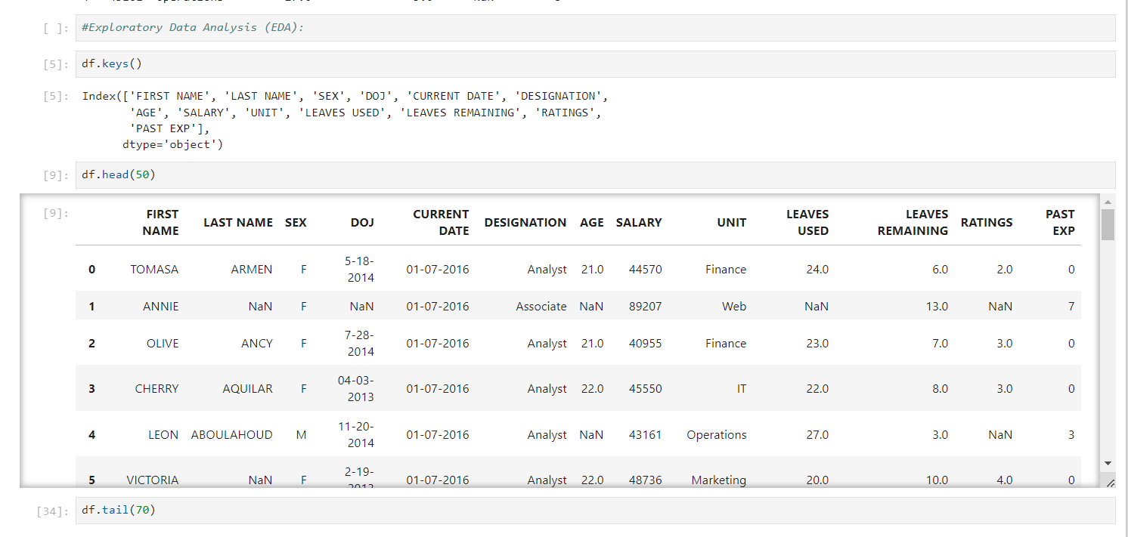
Exploratory Data Analysis (EDA):

Slide 11
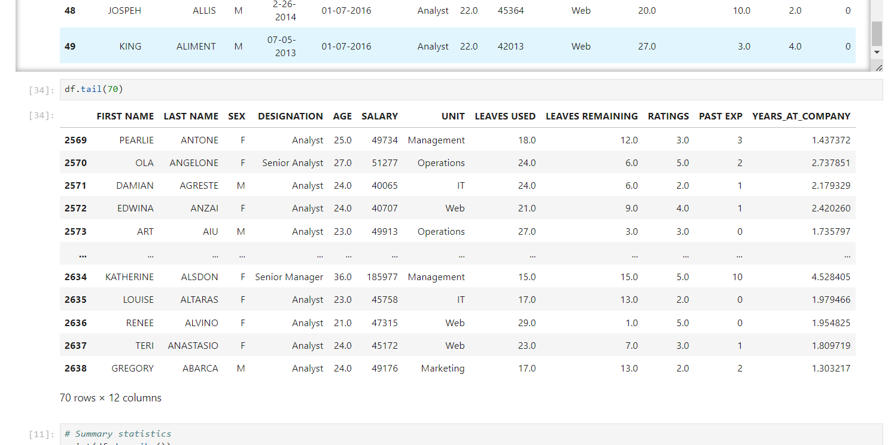

Slide 12
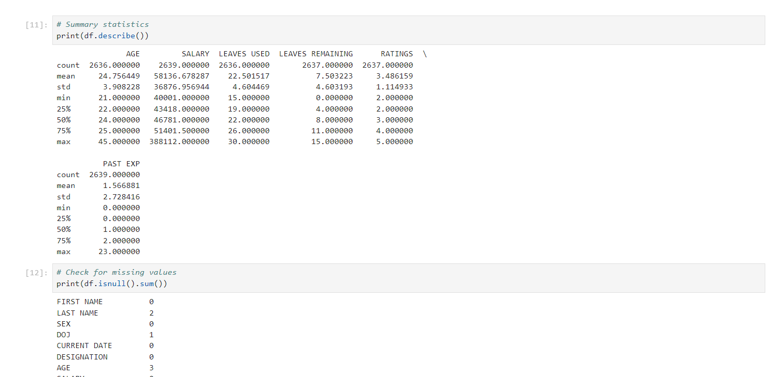

Slide 13
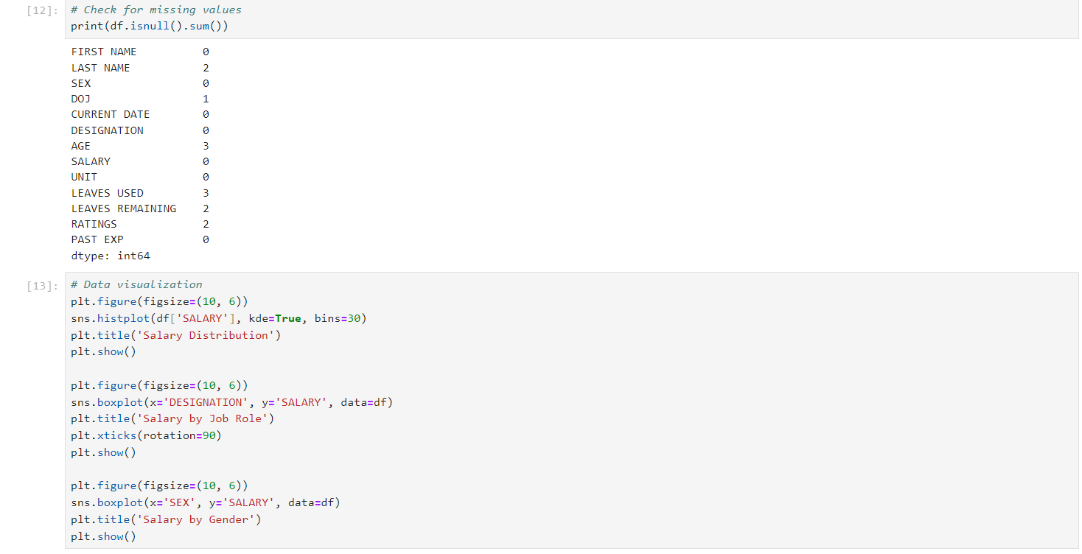

Slide 14
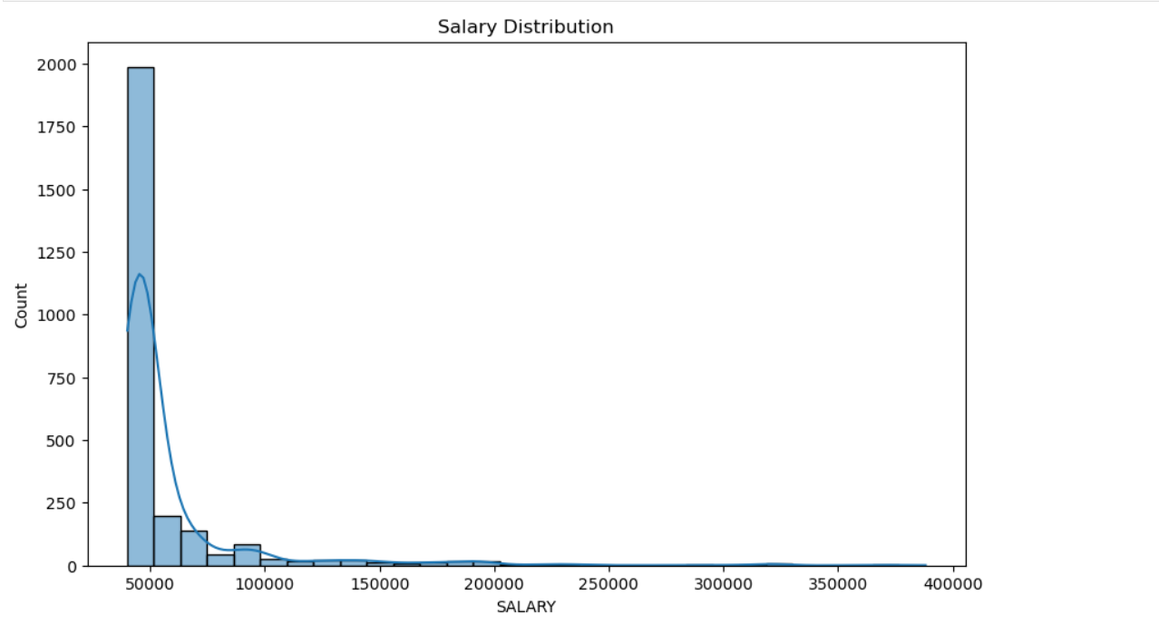
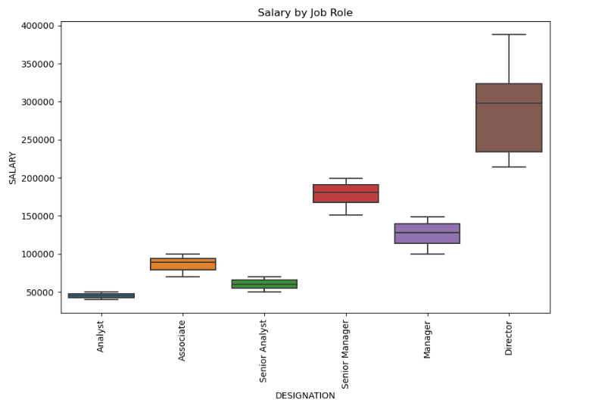

Slide 15
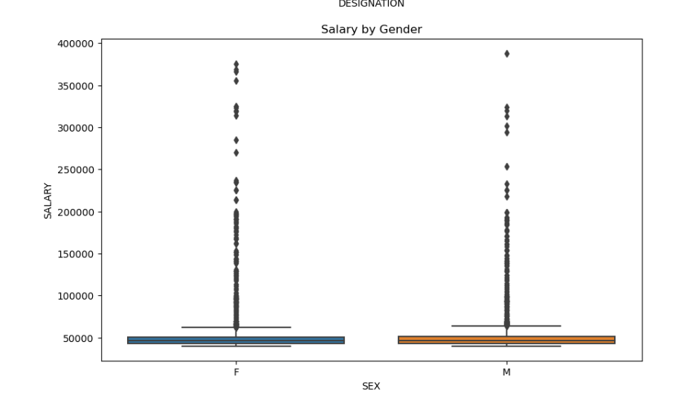
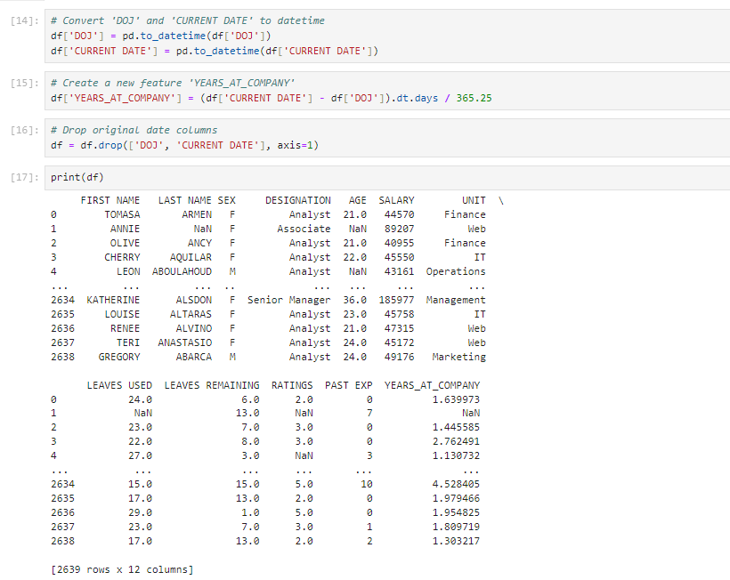
Feature Engineering

Slide 16
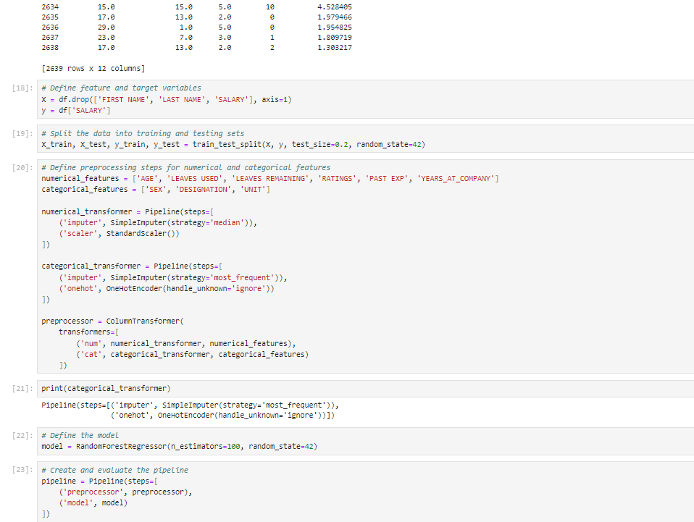
Data Preprocessing:

Slide 17
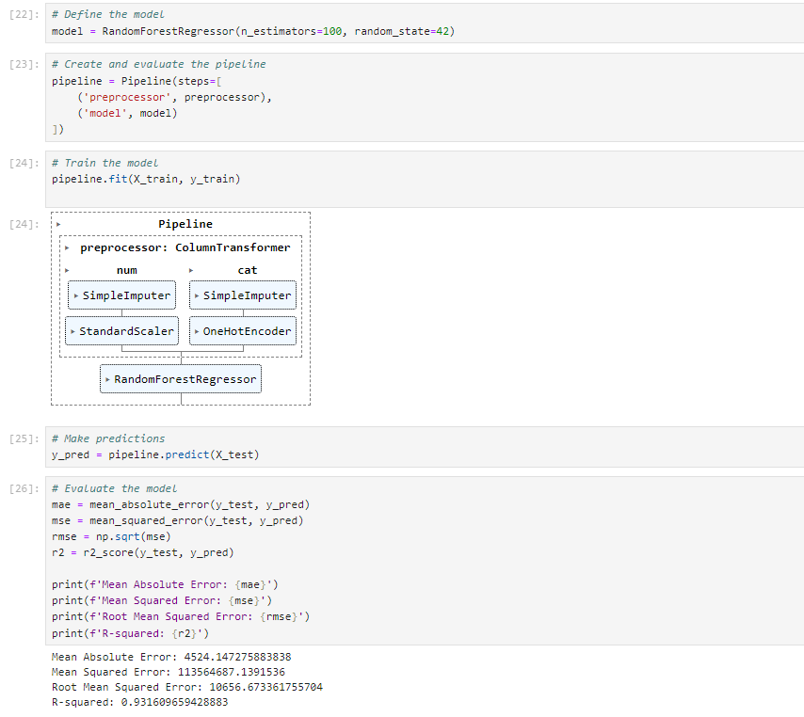
Model Development(RandomForestRegressor):

Slide 18
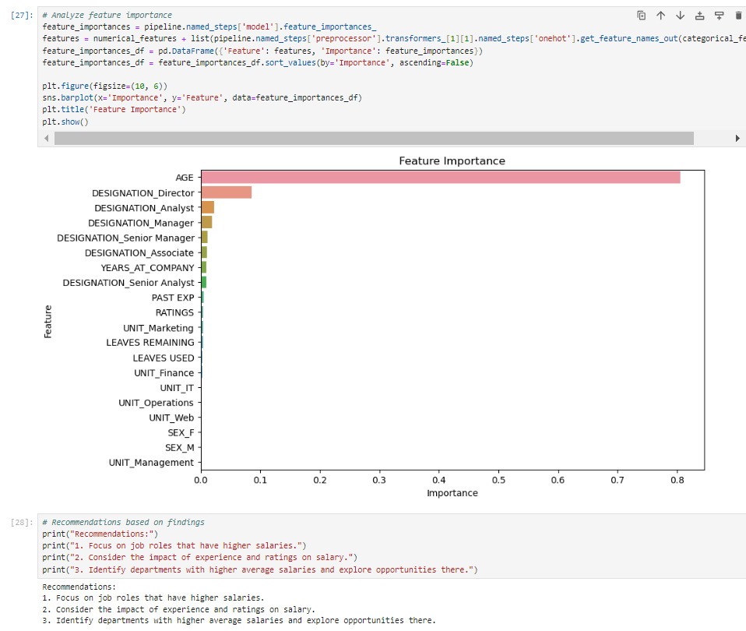
Recommendations:

Slide 19
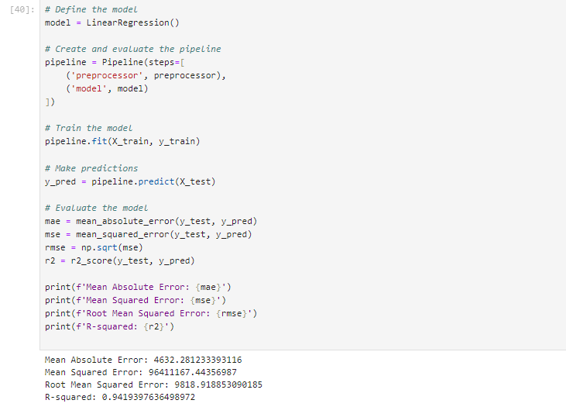
Model Development(LinearRegression):

Slide 20
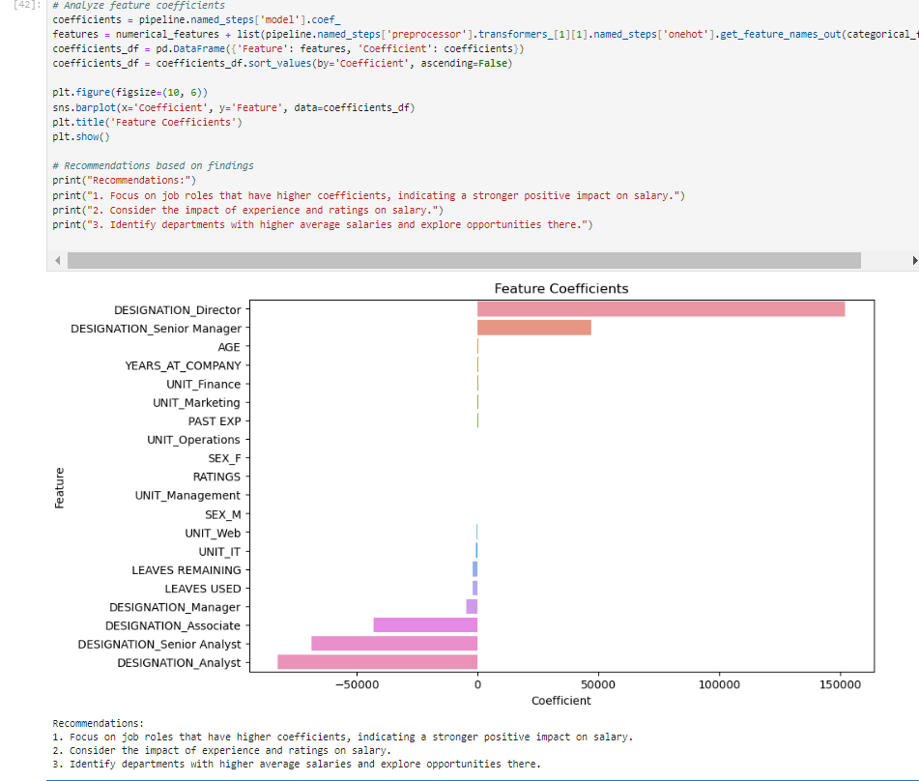
Recommendations:

Slide 21
Conclusion
This internship project successfully demonstrated the application of machine learning to predict salaries in the data profession domain using a linear regression model. Through comprehensive exploratory data analysis, feature engineering, and data preprocessing, we developed a robust model that accurately predicts salaries based on factors like job role, experience, and performance. The model's evaluation metrics indicated strong predictive performance, and the analysis of feature coefficients provided valuable insights for actionable recommendations. This project not only enhanced practical skills in data analysis and machine learning but also provided meaningful contributions to understanding salary dynamics in the data profession.

Slide 22
THANK YOU

